Slide 1
ORIENTAL COLLEGE OF TECHNOLOGY
BHOPAL (M.P.)
“Information Technology”
Minor Project Progress Presentation I
On
“FLAPPY BIRD”
29th Nov 2023
Guided by Presented by:
Prof. Iqbal
Vivek Waryani (0126IT211125)
Sakshi Rajput (0126IT211094)
Divyansh Choudhary (0126IT223D01)
Shilpa Shakya (0126IT211104)
Rahul Acharya ()0126IT211076)

Slide 2
Contents
    Introduction
    Literature Review
    Objective
    Work Plan & Technology used
    Circuit Diagram & Description
    Proposed Methodology/Algorithm
    Expected Outcomes
    Conclusion
    References

Slide 3
Introduction
This project is about the “Flappy Bird Game” which uses py-game module to get organised correctly an efficient manner.
This module contains functions of every basic asset which are crucial for building any game, it contains- physics, blitting ,FPS, clock, 2D and much more.
We used such functions and classes to create Flappy Bird where user can give input to which our avatar reacts and the goal is to pass through all the random generated pipes as far as the user can and get good scores.
But there is a twist, that every time when the avatar passes any pipe the user will get a gradual increment in the speed of the avatar.

Slide 4
Literature Review
Topics to be covered
  Problems statement
  Methodology used
  Simulation parameter used
  Tools / language/simulation enviornment
  Advantages/disadvantages
  Conclusion/results based on used parameter
  Future scope

Slide 5
Template for Literature Review
Problem Statement:
Design and implement a Flappy Bird game using the Pygame library, considering the challenges involved in creating a responsive and engaging gaming experience. The goal is to create a simple yet entertaining game with user-friendly controls and obstacles that progressively increase in difficulty.

Slide 6
Methodology Used:
The development of the Flappy Bird game involves using the Pygame library in Python. Pygame is a set of Python modules designed for writing video games.
The game logic includes handling user input for controlling the bird's movement, managing collision detection with pipes, and implementing a scoring system. The gameplay is based on the classic Flappy Bird mechanics, where the player must navigate a bird through a series of pipes by tapping on the screen to make the bird jump.
Here we used RAD (Rapid Application Development) model to create the software, RAD is a linear sequential software development process model that emphasizes a concise development cycle using an element based construction approach. If the requirements are well understood and described, and the project scope is a constraint, the RAD process enables a development team to create a fully functional system within a concise time period.

Slide 7
Simulation Parameters Used:
Gravity: Simulating the effect of gravity on the bird's movement.
Pipe Generation: Dynamic generation of pipes at regular intervals to create obstacles.
User Input Handling: Capturing user input ( keyboard ) to control the bird's movement.
Collision Detection: Detecting collisions between the bird and pipes to determine game over conditions.
Scoring System: Implementing a scoring mechanism based on the number of pipes successfully passed.
Tools / Language / Simulation Environment:
Language: Python
Library: Pygame
IDE: Any Python IDE (e.g., VSCode, PyCharm)
Simulation Environment: Local machine running Python with Pygame installed

Slide 8
Advantages/Disadvantages:
Advantages:
Simplicity: Pygame simplifies game development, making it accessible for developers of various skill levels.
Cross-Platform Compatibility: Games developed with Pygame can be run on multiple platforms.
Disadvantages:
Performance: Pygame may have limitations in handling complex and resource-intensive games.
Graphics Quality: While suitable for 2D games, Pygame might not be the best choice for high-end graphics.

Slide 9
Conclusion/Results Based on Used Parameters:
The Flappy Bird game, developed using Pygame, demonstrates successful implementation of essential gaming elements. The gravity simulation, dynamic pipe generation, and user input handling contribute to an engaging and challenging gameplay experience. The collision detection mechanism ensures that the game responds appropriately to user actions, providing a satisfying and immersive experience.
Future Scope:
Enhanced Graphics: Improving the visual aesthetics of the game by incorporating more sophisticated graphics and animations.
Multiplatform Support: Adapting the game for deployment on various platforms, such as mobile devices or web browsers.
Leaderboards and Social Integration: Implementing features like online leaderboards and social media integration to enhance competitiveness and community engagement.
Additional Game Features: Introducing new obstacles, power-ups, or levels to keep the game fresh and exciting for players.

Slide 10
    Objective
The primary objectives in Flappy Bird are:
Avoid Collisions: The main goal is to prevent the bird from colliding with the pipes. Each successful pass through a set of pipes earns the player a point.
Achieve a High Score: The game becomes progressively more difficult as the player accumulates points. The speed of the scrolling pipes increases, and the gaps between pipes may become narrower, making it harder to navigate.
Challenge Yourself: The game is designed to be challenging, and one of the objectives is to challenge yourself and others to achieve a higher score. The simplicity of the game mechanics contributes to its addictive nature.

Slide 11
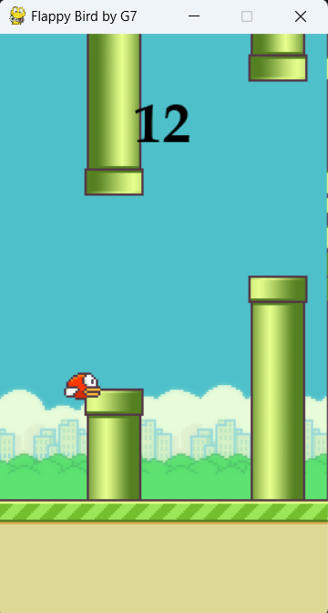

‘isCollide()’ Function
Checks for collisions between the player and pipes or ground.
Plays a 'hit' sound effect if a collision is detected.

Slide 12
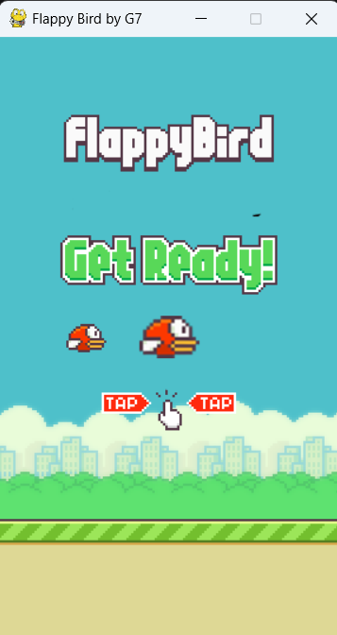
‘welcomescreen()’ Function
Displays welcome images on the screen.
Allows the user to start the game by pressing the spacebar or the up arrow key.
Uses Pygame event handling to manage user input.

Slide 13

Technology Used
We used python as a programming language to create the game by using pygame module.
The module is popular for it’s 90’s game such examples are REDSTAR, TIC TAC TOE, SUDOKU, SNAKE GAME, etc.
Pygame is also used to create GUI applications, multimedia applications, etc.

Slide 14
Proposed Methodology
Attributes
Move
Display Screen
Bird
Jump
Pygame
Objects
Load Images
Attributes
Move
Transform Images
Pipe
Set Height
FLAPPY BIRD
Record Game Time
Attributes
Base
Move
Check Collision
Static Methods
Check Blitting
Main Loops

Slide 15
Work Plan
S.NO | Particulars | Duration | Outcome
1 | Welcome screen | 45 mins | The game should show a small perfect intro at the start of the game.
2 | Main game | 4 – 5 days | The first appearance and positioning of every sprite of the game.
3 | Collision | 2 days | The collision of the bird if the bird touches any part of the pipe.
4 | Random pipe | 6 hours | The random generation and movement of pipe to which the bird will pass.
5 | Initialisation of all python modules | 30 mins | The resources of the game will start to call the functions as per the code.

Slide 16
Expected Outcomes
The game must not crash at any moment.
Avatar must not glitch at any place.
The random pipes generated must not locate at unrequired coordinate.
The sprites blitting should not be irregular.
The distance between each pipe should be same.
+

Slide 17
Applications
Game Development
Educational Purposes
Simulations and Visualizations
Multimedia Applications
Art and Music Projects
GUI Applications

Slide 18
Conclusion
In conclusion, the Flappy Bird Project demonstrated the successful development of a classic game while laying the groundwork for future enhancements. The game's simplicity and appeal were highlighted, and avenues for future improvements were discussed. The project not only served as an exploration of game development but also as a springboard for potential innovations and expansions
Recommendations for future work include enhancing graphics, exploring multi-platform support, incorporating additional game features, and integrating online elements such as leaderboards and social media interaction. These suggestions aim to elevate the gaming experience and broaden the project's scope.

Slide 19
References
The project was created upon a variety of references, including academic literature, programming documentation, and relevant online resources, ensuring a well-informed development approach.
https://pngtree.com/so/1-to-10
https://www.freepik.com/free-photos-vectors/game-background
https://www.zapsplat.com/sound-effect-category/game-sounds/
https://studio.youtube.com/channel/UC-PYa26rN_bbQZgNRmIYqTQ/music
https://www.pngwing.com/en/search?q=birds
https://ieeexplore.ieee.org/document/8924807
https://ieeexplore.ieee.org/document/9763893

